Slide 1
Assessment 2: Group Project Presentation
HIT140 FOUNDATIONS OF DATA SCIENCE
Group- 73
Team Members | ID
Md. Iftakharul Alam Chowdhury | S372376
Mohammed Sajid Salim | S372433
Rupam Golder | S392014

Slide 2
Research Context
Species: Egyptian Fruit Bats & Black Rats
Setting: Semi-natural colony, food platform, 7-month observation
Key Question: Do bats perceive rats as predators?
Hypothesis: If rats are threats → bats show avoidance/vigilance

Slide 3
Objective
We aim to determine whether bats view rats not only as competitors for food but also as potential predators. If bats perceive rats as a predation threat, this should be reflected in stronger avoidance behaviors or heightened vigilance when bats forage on the food platform.
Key Figures:
Use data science methods (Python only) to test whether bats treat rats as potential predators.
Analyze risk-taking behavior (risk=1) vs risk-avoidance (risk=0).
Combine descriptive statistics, inferential tests, and regression models.

Slide 4
Datasets
Datasets Overview:
dataset1.csv: Individual bat–rat events.
dataset2.csv: Aggregated 30-min observation periods.
Data Cleaning & Preparation:
Converting datetimes,
coercing numerics.
Creating bins for “seconds after rat arrival”.Filtering missing values.

Slide 5
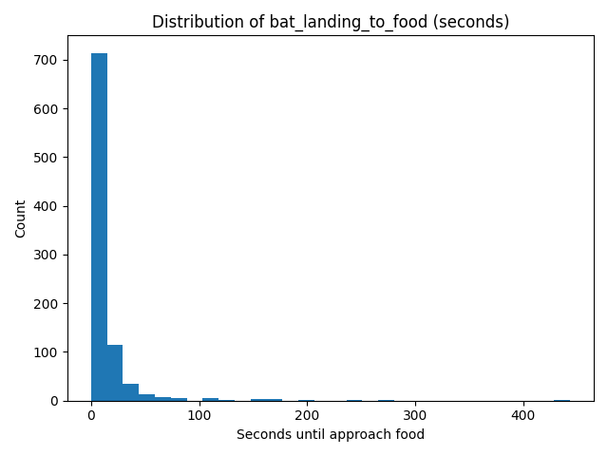
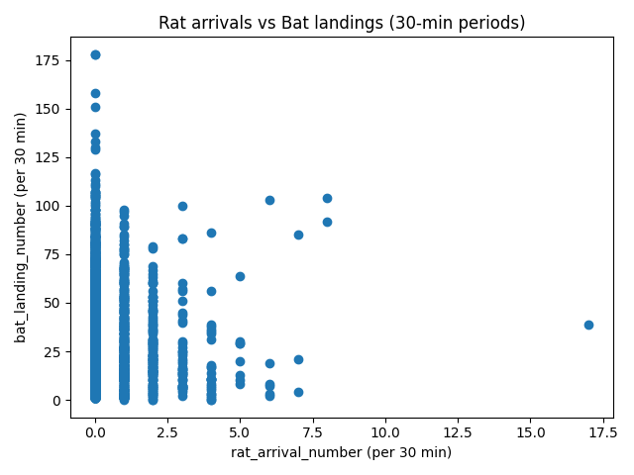
Descriptive Insights
Histogram: bat_landing_to_food → right-skewed distribution.
Scatterplot: More rat arrivals generally coincide with more bat landings.

Slide 6
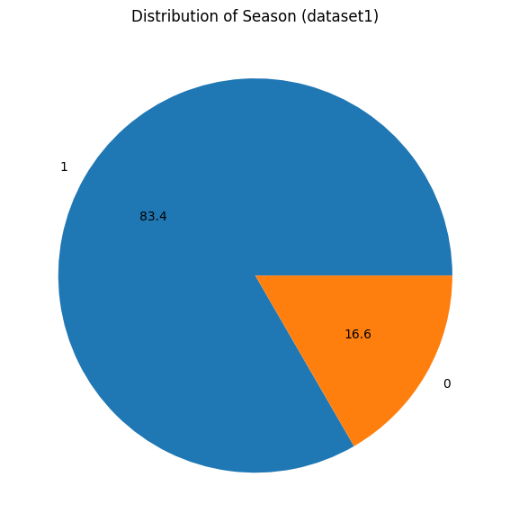
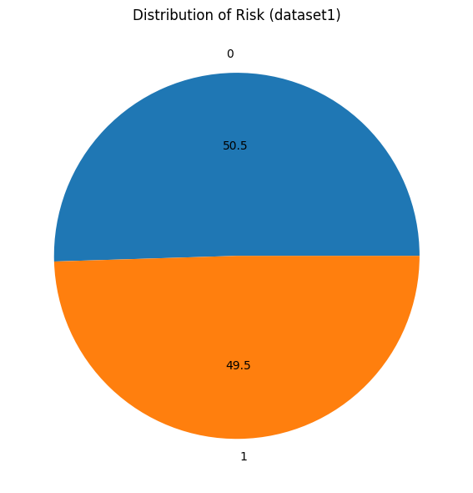
Descriptive Insights
Piechart: Distribution of season and distribution of risk

Slide 7
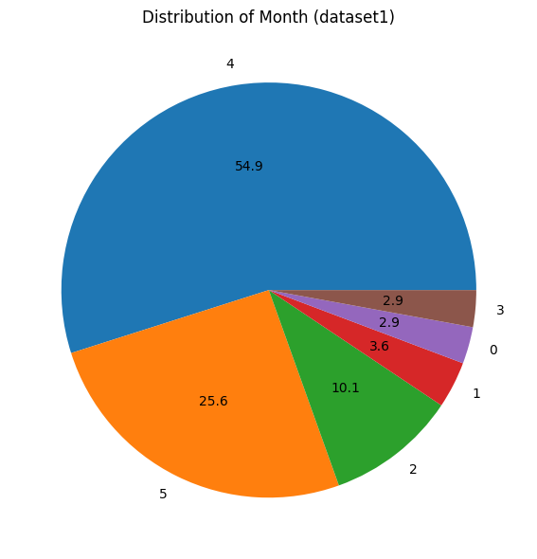
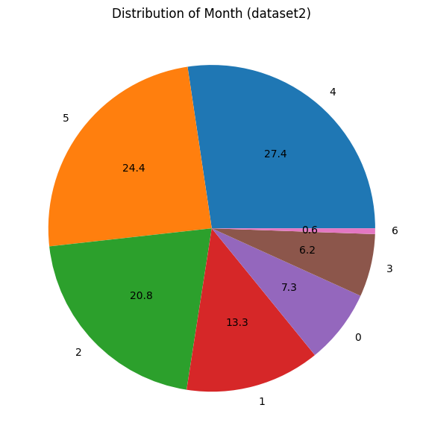
Descriptive Insights
Piechart : Distribution of month

Slide 8
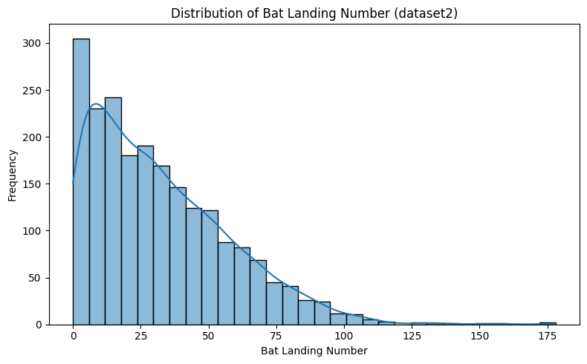
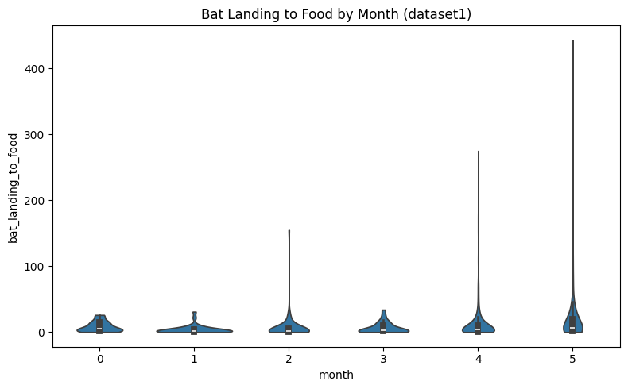
Descriptive Insights
Histogram: Distribution of Bat landing Number and Bat landing to food by month

Slide 9
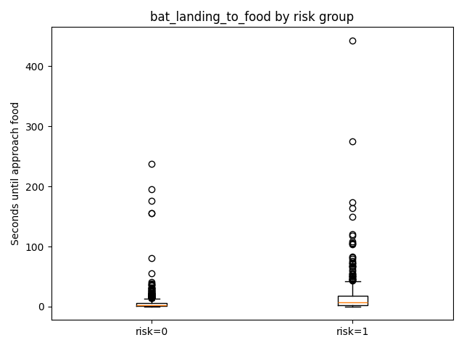
Mann–Whitney U Test
Question: Do risk-taking vs. risk-avoidance bats differ in time-to-food?
Medians: Risk=0 → 2 s, Risk=1 → 7 s
U = 68,002, p < 0.0000000000000000001
Cliff’s delta = 0.34 (moderate effect)
Interpretation: Risk-taking bats delayed feeding more than avoidance bats.

Slide 10
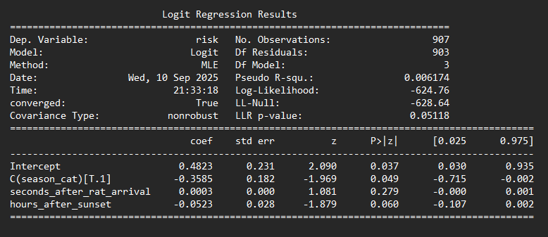
Logistic Regression
Model: risk ~ season + seconds_after_rat_arrival + hours_after_sunset
Season effect: borderline significant (p = 0.049)
Hours after sunset: borderline (p = 0.060)
Rat arrival timing: not significant (p = 0.279)
Pseudo R² = 0.006 (weak explanatory power)
Takeaway: Seasonal differences exist, but overall predictors weak.

Slide 11
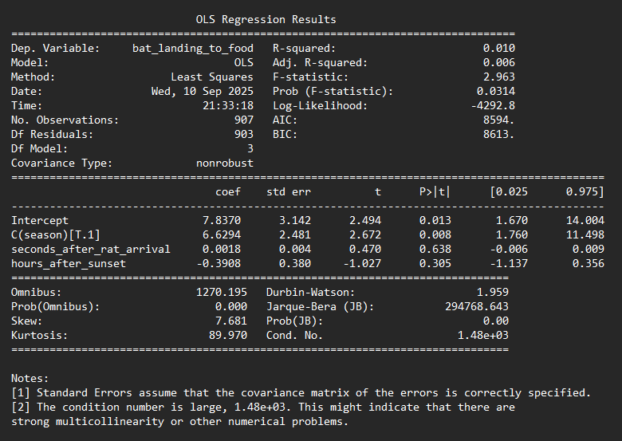
Linear Regression
Model: bat_landing_to_food ~ season + seconds_after_rat_arrival + hours_after_sunset
Season → +6.6 seconds (p = 0.008)
Other predictors non-significant
R² = 0.01 (weak explanatory power)
Takeaway: Season modestly increases bat hesitation before approaching food.

Slide 12
Key Conclusions
Bats change behaviour in presence of rats.
Risk-taking bats take longer to approach food.
Seasonal variation influences both risk behaviour and approach time.
Evidence supports: bats perceive rats as competitors and potential threats.
Predictive models weak → behaviour likely influenced by unmeasured ecological factors.

Slide 13
Thank You

